Slide 1
Capstone Presentation
Submitted by – Yash Saxena
Topic – Analysis of the CTC to be offered to the candidates applying for the position at Delta Ltd.

Slide 2
Business Problem Understanding
The HR department of Delta Ltd. is looking to be more data oriented in terms of their CTC offering to the new employees in order to meet the industry standards, align with the expectations of the candidate, and to reduce biasness.
This ML based project can have the following use cases (including but not limited to):
1. Estimating a fair and competitive CTC for a new hire
2. Evaluating the parameters which affect the compensation to be offered to the new hires in order to improve the talent hunt process and anticipate the monetary loss should an existing employee parts way or asked to leave
3. Improving the talent hunt process by trying different combinations of parameters of the candidates which influence the compensation offered

Slide 3
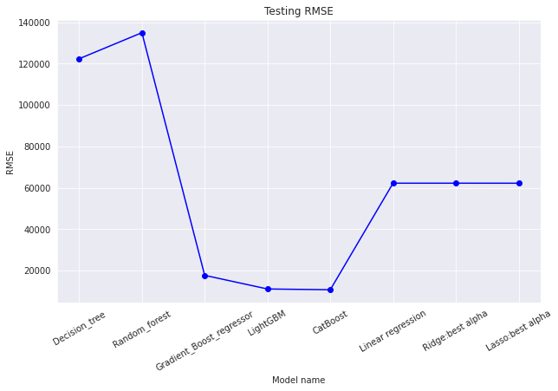
Modeling approach used
Modelling approach was selected on the basis of performance as judged by RMSE
RMSE was selected as the chosen parameter for judgement
On the basis of RMSE the models performed as given in the graph below :
Basis the performance by RMSE, CatBoostRegressor was chosen
The reason for choosing RMSE was the preference of penalizing large errors as the company would not want to have large errors however, smaller errors would not be of much problem.
Other reason for choosing CatBoost or a tree based model was the presence of multicollinearity

Slide 4
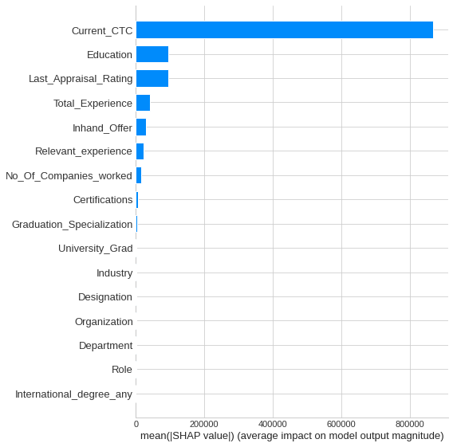
Insights from Analysis
Analysis began with 28 features and the analysis was done with 16 features as most of them were dropped due to redundancy of the information given by them. 2 features were removed because of the presence of missing values in them. These were University PHD and PHD specialization
SHAP values were used to explain the impact of each of the predictor on the outcome
As expected, Current CTC was the most important predictor for CTC to be offered
Having an international degree doesn’t have any impact on the expected CTC
Fig : Global Impact of each feature on the CTC offered

Slide 5
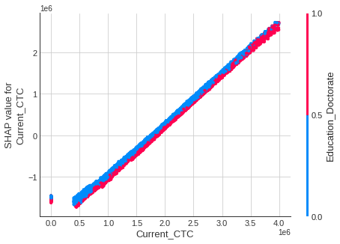
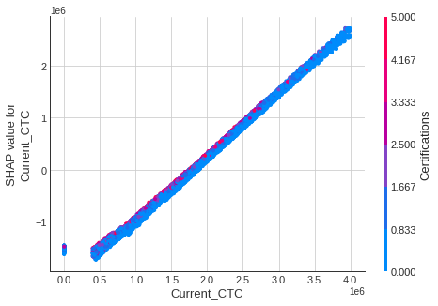
Fig : SHAP value plot of Current CTC with interaction effect of Education doctorate
Fig : SHAP value plot of Current CTC with interaction effect of certifications
How Current CTC is changing expected CTC for different set of candidates?
For PHD level candidates, the impact of current CTC on expected CTC is less for candidates having lower current CTC
It is good to have done certification courses because having done certification courses brings more impact of the current CTC on the expected CTC
It is not expected from high current CTC candidates and/or high total experience candidates to have last appraisal rating received as C or D

Slide 6
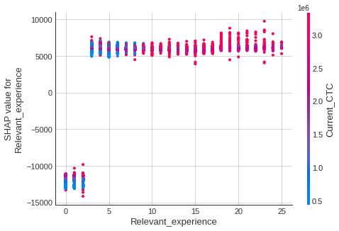
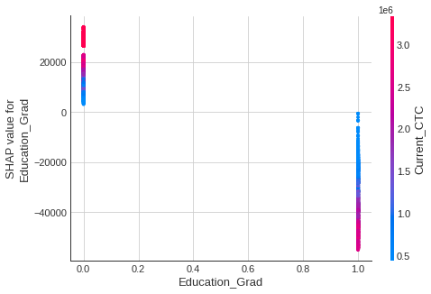
Not having any relevant experience is not much of a concern and will not cause much negative impact on the increment on current CTC
But to have significant positive impact the candidate must have at least 3 years of relevant experience
Fig : SHAP value plot of relevant experience with interaction effect of Current CTC
If candidate is just a graduate even if the current CTC is very high the impact on expected CTC turns negative
This impact reduces if the candidate has done some certifications
Fig : SHAP value plot of grad education with interaction effect of Current CTC

Slide 7
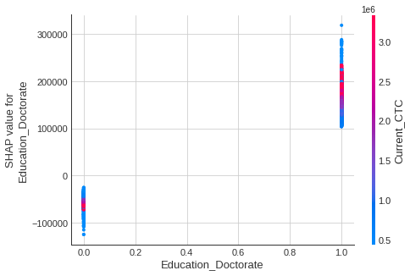
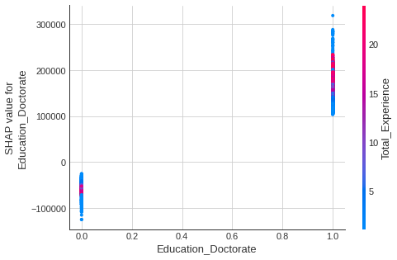
Inclination towards Doctorate candidates
Fig : SHAP value plot of PHD education with interaction effect of Current CTC
Fig : SHAP value plot of PHD education with interaction effect of Total experience
PHD candidates are anticipated to have increment in the expected value of CTC to be offered from current CTC whereas the non-PHD candidates are expected to receive decrement in the expected value of CTC
The total experience of the candidates is not of much importance if the candidate is PHD

Slide 8
Recommendations
Certifications could be taken as a potential parameter to judge candidates with relatively lower level of formal education. Evidently, freshers with certifications are able to secure good offer
The distribution of current location and preferred location is spread across many cities while not converging to just one city so company can offer remote location opportunities
Not much impact is being generated by learning the place of university of highest/all level of education. This might create some biasness basis the location so could get away with this feature
Interestingly, 24% of candidates with an offer in hand did not do graduation. Therefore, hiring team can be a bit flexible about the educational level requirements

Slide 9
That’s all folks! Questions?

